Slide 1
Lawrence Odhiambo
BBIT/2017/63047

Slide 2
E-commerce, car rental management system

Slide 3
Team, Developer
Lawrence Ochieng Odhiambo
BBIT/2017/63047

Slide 4
Inspiration
The high cost of vehicle ownership, and the ever increasing demand of movement in the day to day activities which require different types of vehicles. For example, fo urban settings, a small sedan or city car is ideal, for long distance the ideal vehicle is a large sedan or an SUV, for offroad travels, one needs a 4X4. A person would need to own all these types of vehicles to move accommodate all the movements.
This projects is designed to help organisations that offer rental services to easily manage and meet their customers

Slide 5
Technologies used
Html
Php, Sql(mysql)
Bootstrap
CSS

Slide 6

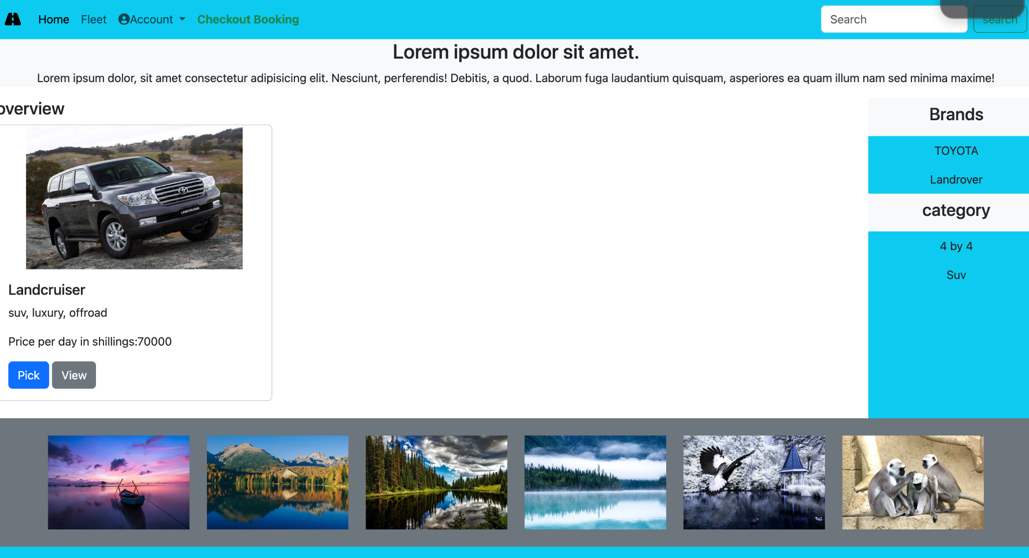

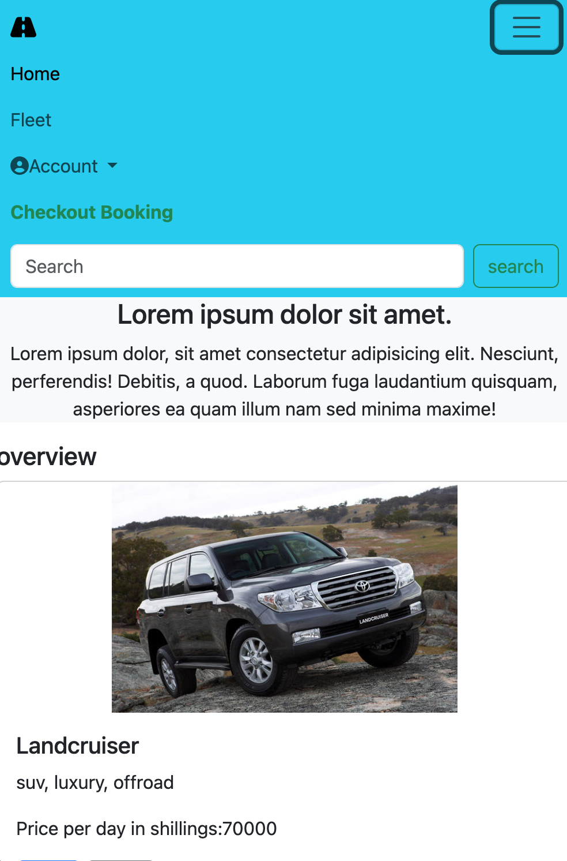
car rental management system

Slide 7
Algorithms
Being a web application the major algorithms involved include but not limited to,
Search - one can search for a particular product
Create - one can create an account or a product entity within the account
Update - one update an account or a product entity within the account
Read - one can read the real time data presented by the API
Delete - some of the data entities can be deleted

Slide 8
Snippets and appearance
Register user snippets
$insert_query = "INSERT INTO `customer_table` (user_name, user_email, user_password, user_image, user_ip_address, user_address, user_mobile)
VALUES ('$user_username', '$user_email', '$hashed_password', '$user_image', '$user_ip', '$user_address', '$user_contact')";
$sql_execute = mysqli_query($con, $insert_query);

Slide 9
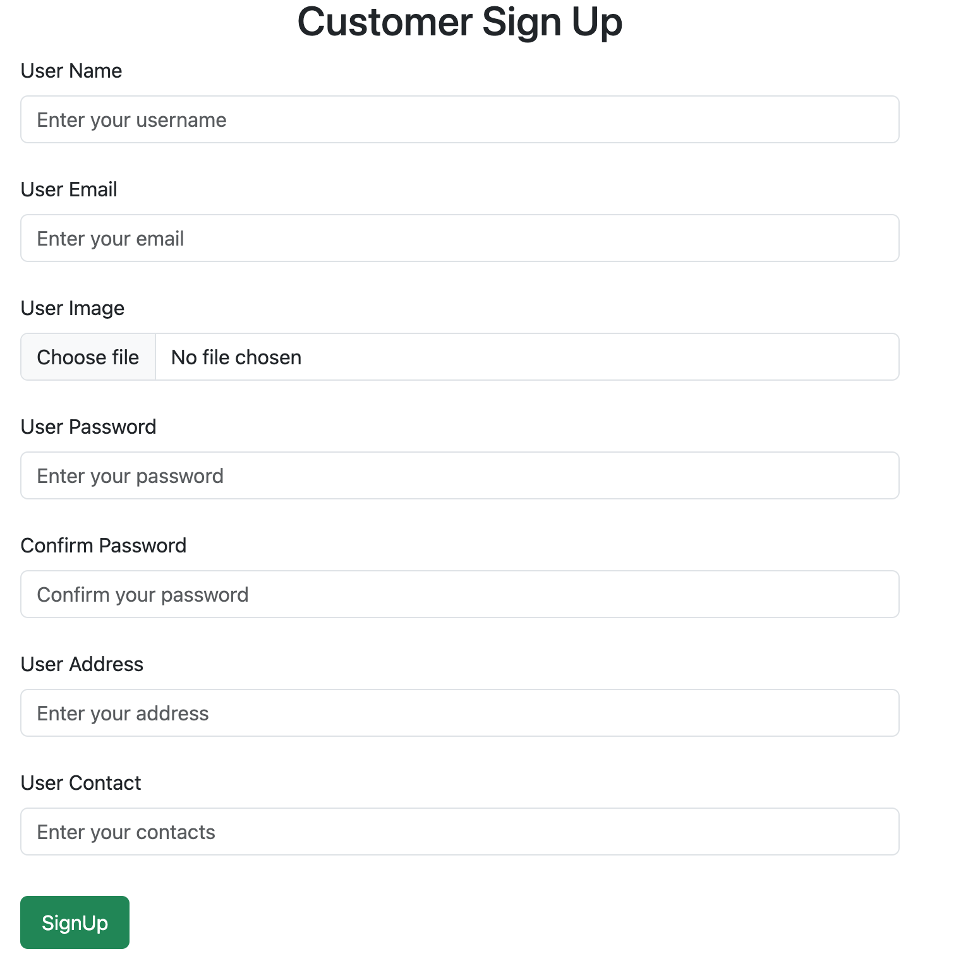

Slide 10
Home page Desktop

Slide 11
Home page mobile

Slide 12
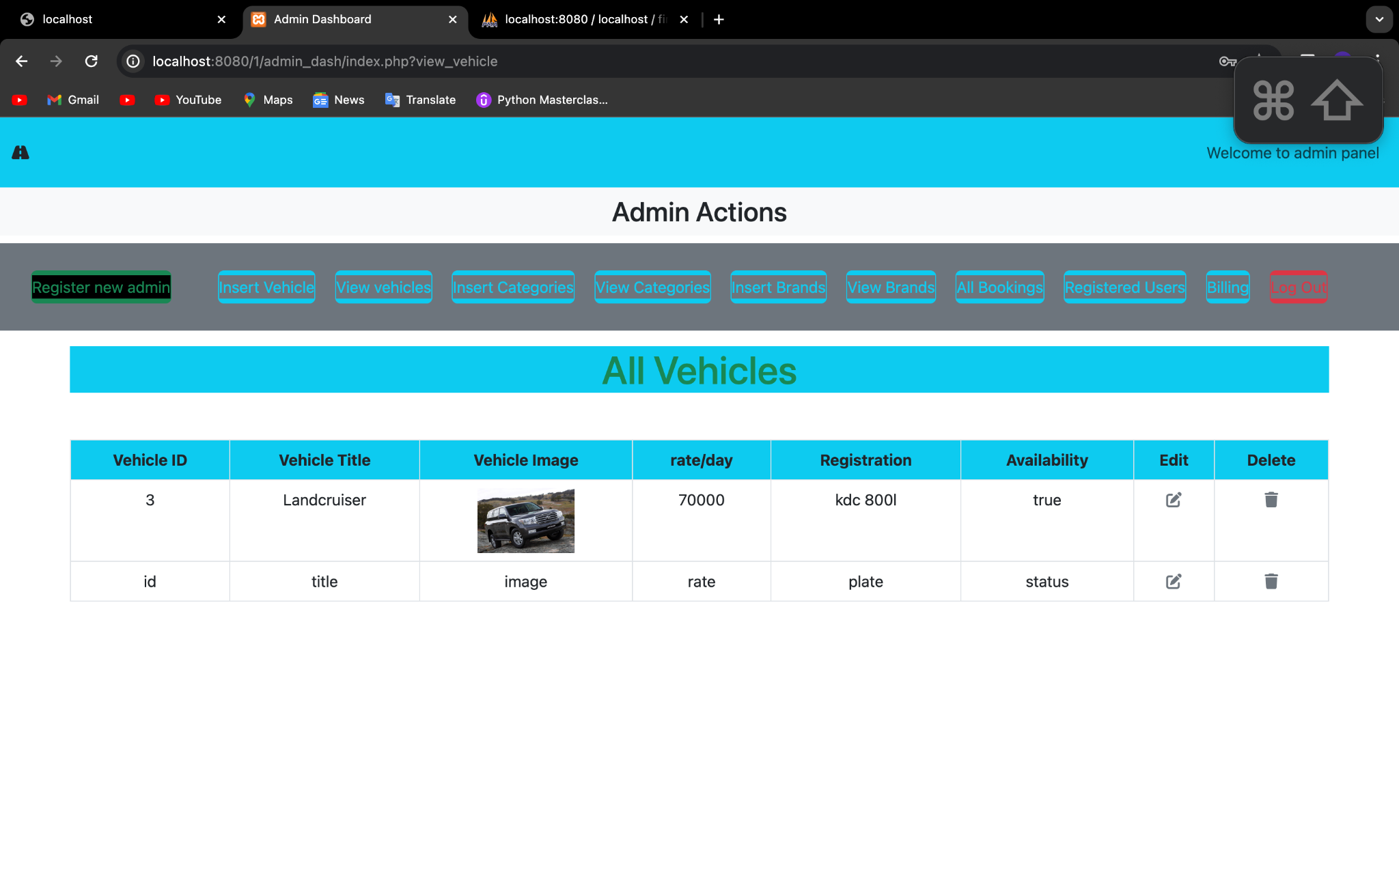
Admin Dash

Slide 13
Development challenges
The project was time intensive and I might have missed one or two things but I believe it has all the required parts to be a minimum viable product
During development, I faced a few challenges which include but not limited to
Planning
Limited resources
Power outages
Lack of different points of view

